Slide 1
IN&ON: This or that – Tick the correct spelling
 | Option 1 | Option 2
1 | Je m’appelle | Je m’apple
2 | Au revwah | Au revoir
3 | Ça va? | Ca va?
4 | Bonjoor | Bonjour
5 | Ay toi? | Et toi?
EfL+:
How many words can you remember how to spell from our lessons so far this term? Write a list under the IN&ON task.

Slide 2
IN&ON: This or that – Tick the correct spelling
 | Option 1 | Option 2
1 | Je m’appelle | Je m’apple
2 | Au revwah | Au revoir
3 | Ça va? | Ca va?
4 | Bonjoor | Bonjour
5 | Ay toi? | Et toi?
EfL+:
How many words can you remember how to spell from our lessons so far this term? Write a list under the IN&ON task.

Slide 3
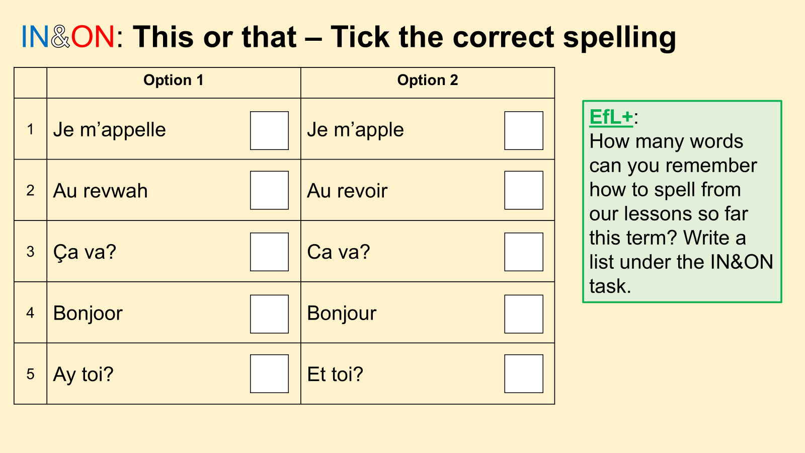

Slide 4
La grande idée: Theme 1: People and Lifestyle | Lesson 4: Mon âge | La question du jour: Can I say how old I am in French?
L’objectif:
Can I say numbers 1-15 in French and say how old I am?
OUTCOMES:
Can I identify key phonics?
Can I apply key phonics when speaking?
Can I recognise 15 numbers in French?

Slide 5
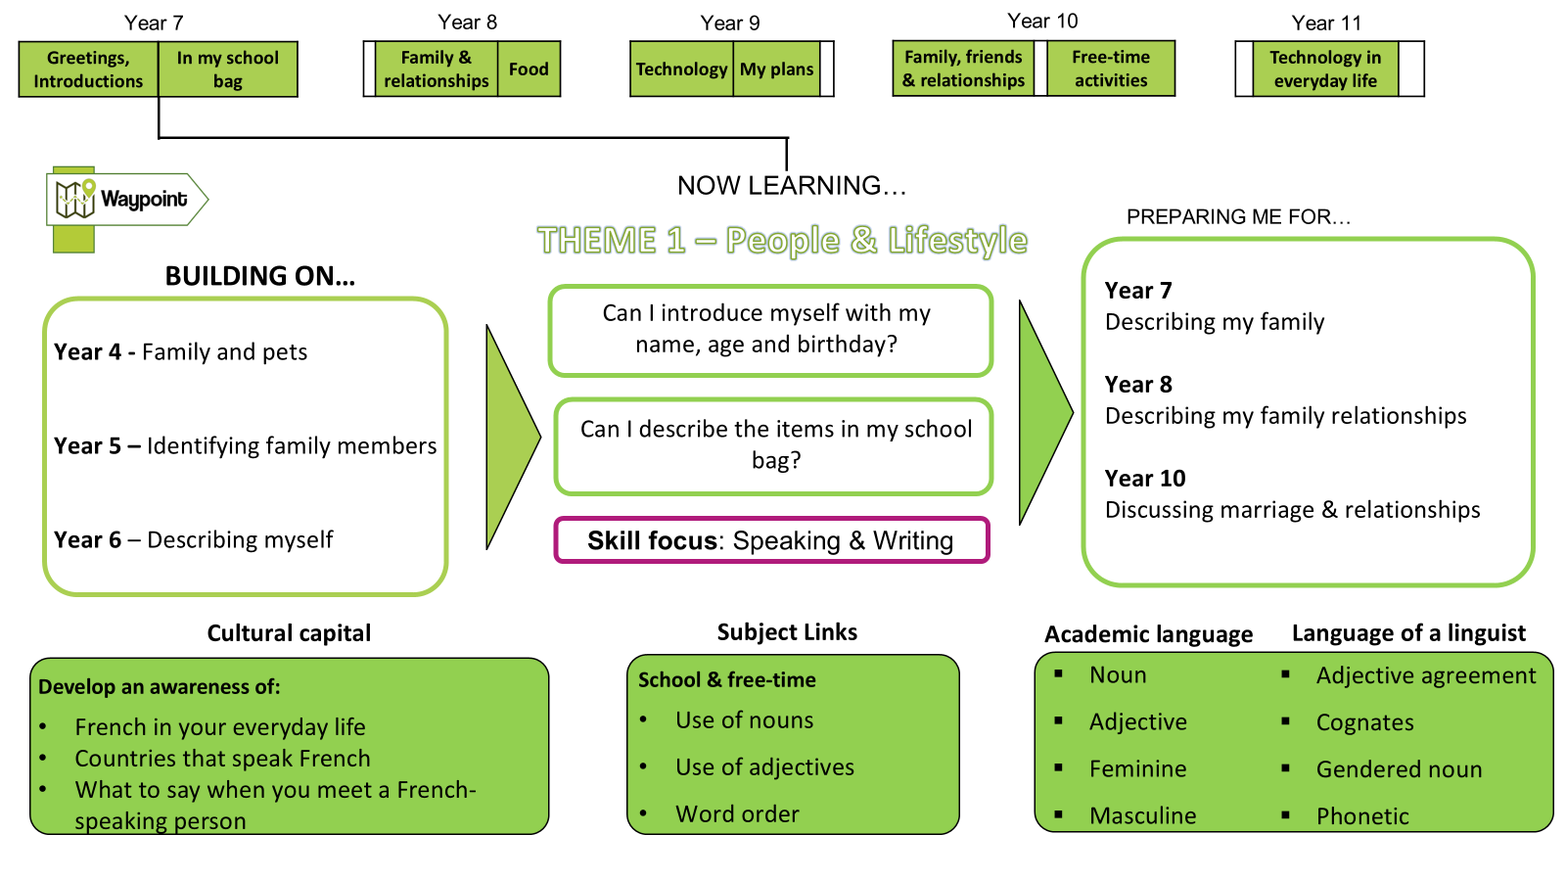

Slide 6

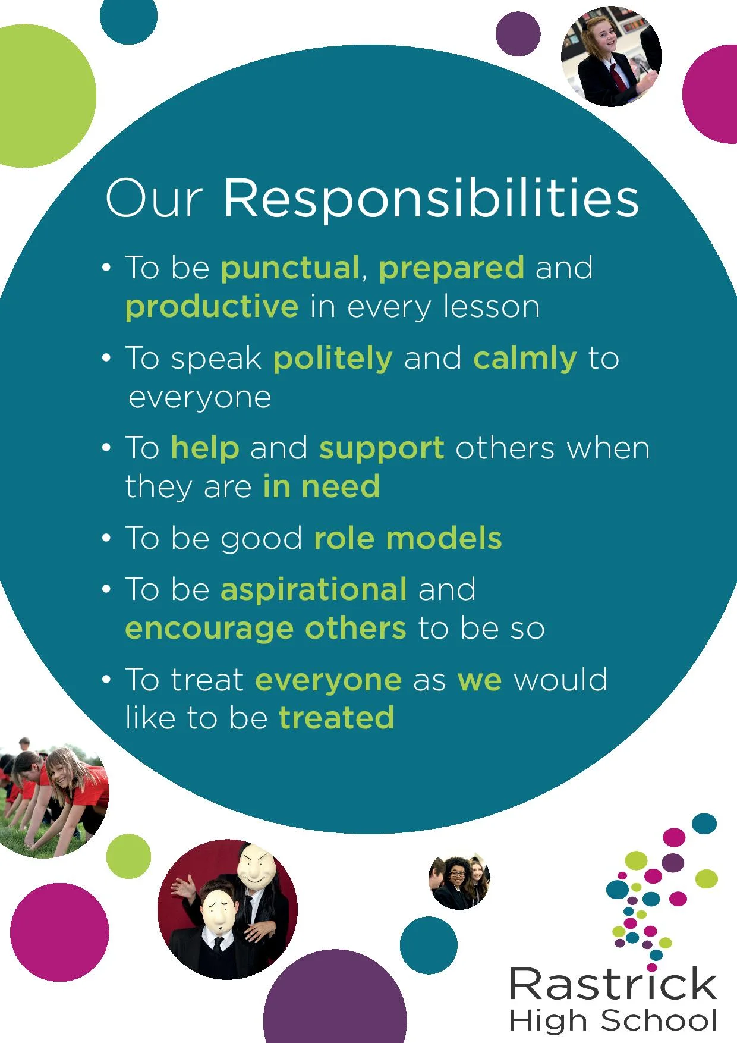

Slide 7
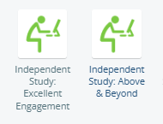
Independent Study - Reminder
You may not yet have access to ClassCharts, so this first piece of Independent Study is optional!
Research French products, and things that make you think of France (The Eiffel Tower, perhaps?).
Bring in pictures to glue onto the front cover of your exercise book.
If you complete this task, we will award you achievement points for excellent engagement and going above and beyond!

Slide 8
La grande idée: Theme 1: People and Lifestyle | Lesson 4: Mon âge | La question du jour: Can I say how old I am in French?
L’objectif:
Can I say numbers 1-15 in French and say how old I am?
OUTCOMES:
Can I identify key phonics?
Can I apply key phonics when speaking?
Can I recognise 15 numbers in French?

Slide 9
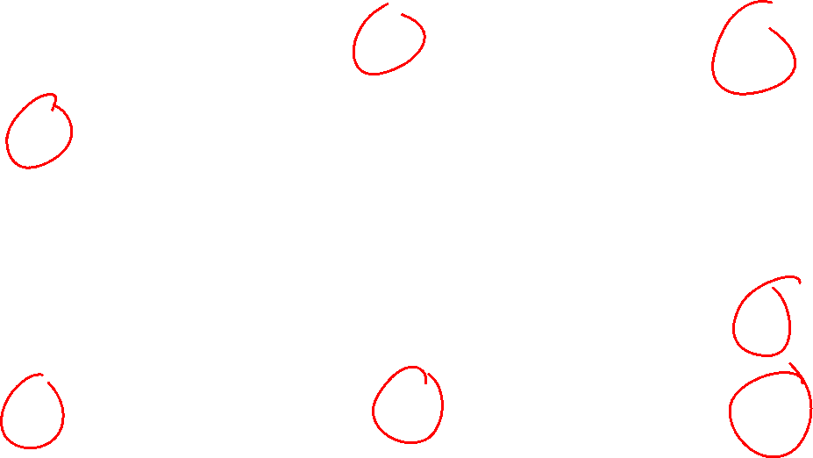
Vocab Flooding – Listen and Repeat
1 un | 6 six | 11 onze
2 deux | 7 sept | 12 douze
3 trois | 8 huit | 13 treize
4 quatre | 9 neuf | 14 quatorze
5 cinq | 10 dix | 15 quinze

Slide 10
La grande idée: Theme 1: People and Lifestyle | Lesson 4: Mon âge | La question du jour: Can I say how old I am in French?
L’objectif:
Can I say numbers 1-15 in French and say how old I am?
OUTCOMES:
Can I identify key phonics?
Can I apply key phonics when speaking?
Can I recognise 15 numbers in French?

Slide 11

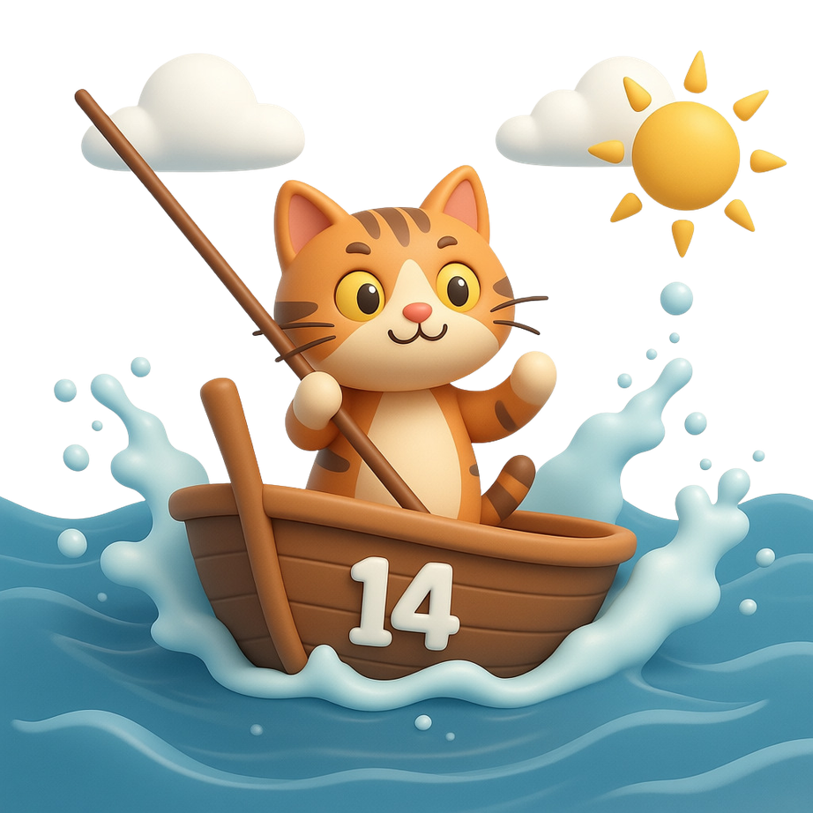






Phonics Help:
cease

Slide 12
La grande idée: Theme 1: People and Lifestyle | Lesson 4: Mon âge | La question du jour: Can I say how old I am in French?
L’objectif:
Can I say numbers 1-15 in French and say how old I am?
OUTCOMES:
Can I identify key phonics?
Can I apply key phonics when speaking?
Can I recognise 15 numbers in French?

Slide 13

10
1
7
6
3
2
4
14
15
5
8
9
12
13
11

Slide 14
Vocab Flooding – Listen and Repeat
Quel âge as-tu? What age do you have? | J’ai onze ans, I have 11 years, J’ai douze ans, I have 12 years, | et toi ? and you ?
zhay
on
kel
arge
ah
too
dooze

Slide 15
Eurêka !
Create a 3 by 3 bingo square
Randomly put numbers from 1-15 in each box. You cannot use a number more than once.
Listen to your teacher read a number out in French. If you have the number, cross it out.
First we are playing for a line of three – once you have three numbers in a row, shout EURÊKA!
Then we will play for a full house.
2 | 14 | 7
3 | 5 | 6
12 | 11 | 8

Slide 16
La grande idée: Theme 1: People and Lifestyle | Lesson 4: Mon âge | La question du jour: Can I say how old I am in French?
L’objectif:
Can I say numbers 1-15 in French and say how old I am?
OUTCOMES:
Can I identify key phonics?
Can I apply key phonics when speaking?
Can I recognise 15 numbers in French?

